Slide 1
Data Science Model Evaluation Parameters

Slide 2
The idea of building data science models works on a constructive feedback principle.
You build a model, get feedback from metrics, make improvements and continue until you achieve a desirable accuracy.
Evaluation metrics explain the performance of a model.
The important aspect of evaluation metrics is their capability to discriminate among model results.

Slide 3
Evaluation Parameters for Regression Models
Correlation
R²
MSE
RMSE
MAE
Accuracy

Slide 4
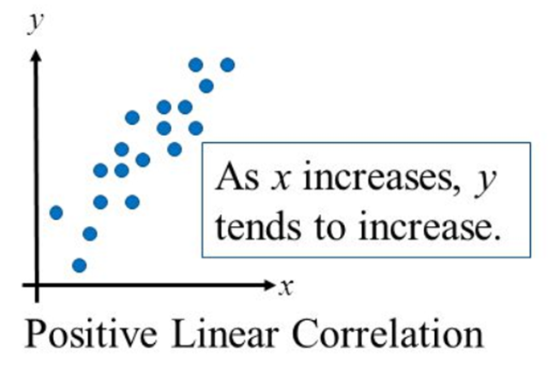
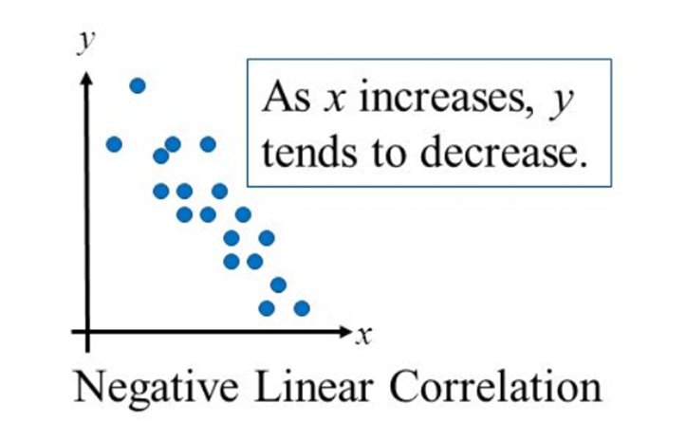
1. Correlation
Correlation is a statistical measure that indicates the extent to which two or more variables fluctuate together.
Correlation varies between -1 to 1.

Slide 5
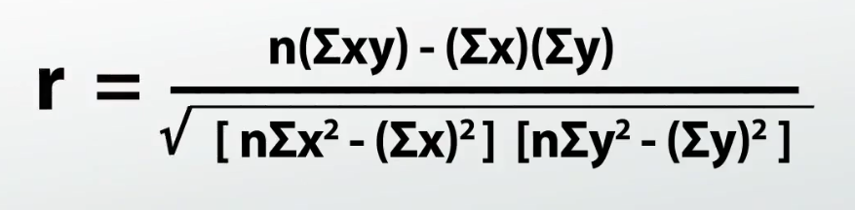
Pearson Correlation (r)
Actual Values | Predicted Values
5.1 | 3.5
4.9 | 3.0
4.7 | 3.2
4.6 | 3.1
5.0 | 3.6
Correlation between the actual and predicted values is ??

Slide 6
2. R² : Coefficient of determination
The coefficient of determination is a number between 0 and 1 that measures how well a statistical model predicts an outcome.
R² = r * r
R² describes the proportion of variance of the dependent variable explained by the regression model.
If the regression model is perfect then R² is 1 and if the regression model is a total failure then R² is zero i.e. no variance is explained by regression.

Slide 7
Significance of R² Score
R-squared is a statistical measure of how close the data are to the fitted regression line.
0% indicates that the model explains none of the variability of the response data around its mean.
100% indicates that the model explains all the variability of the response data around its mean.
Higher the R-squared, the better the model fits your data

Slide 8
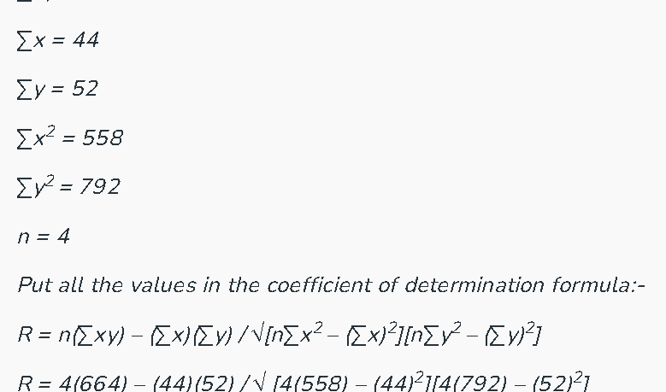
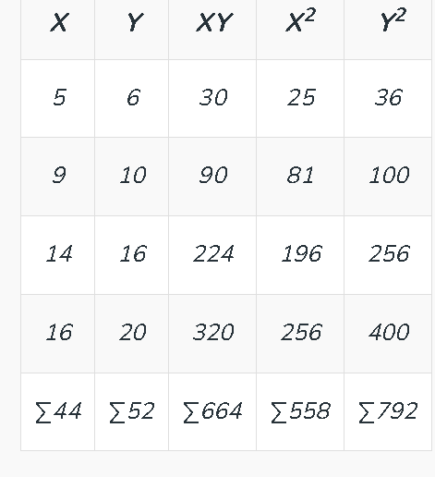
Example of R² Score
Compute the coefficient of determination.
X = 5 ,9 ,14, 16
Y = 6, 10, 16, 20
Now do the square of correlation coefficient
R² = (0.993)² = .987
Convert the R-squared into the percentage
.987 × 100 = 98.7%
So, 98.7% variation of y can explained by x-variables.

Slide 9
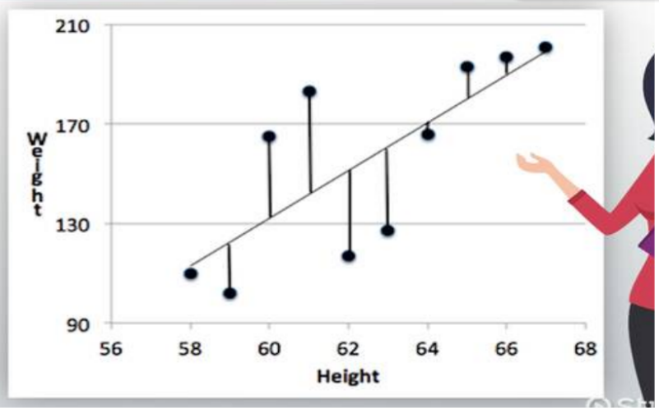
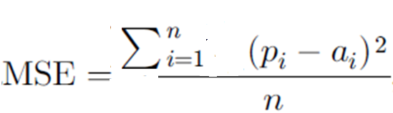
3. MSE
The Mean Squared Error (MSE) is a measure of how close a fitted line is to data points. For every data point, you take the distance vertically from the point to the corresponding y value on the curve fit (the error), and square the value.
Where p is predicted value, a is actual value and n is total number of observations.

Slide 10

MSE Example
Find the MSE for the following set of values: (43,41), (44,45), (45,49), (46,47), (47,44).
Step 1: Find the regression line. As
line y = 9.2 + 0.8x.
Step 2: Find the new Y’ values:
9.2 + 0.8(43) = 43.6
9.2 + 0.8(44) = 44.4
9.2 + 0.8(45) = 45.2
9.2 + 0.8(46) = 46
9.2 + 0.8(47) = 46.8
Step 3: Find the error (Y – Y’):
41 – 43.6 = -2.6
45 – 44.4 = 0.6
49 – 45.2 = 3.8
47 – 46 = 1
44 – 46.8 = -2.8
Step 4: Square the Errors:
-2.6² = 6.76
0.6² = 0.36
3.8² = 14.44
1² = 1
-2.8² = 7.84
This table shows the results so far:
Step 5: Add all of the squared errors up: 6.76 + 0.36 + 14.44 + 1 + 7.84 = 30.4.
Step 6: Find the mean squared error: 30.4 / 5 = 6.08.
The smaller the mean squared error, the closer you are to finding the line of best fit.

Slide 11
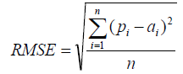
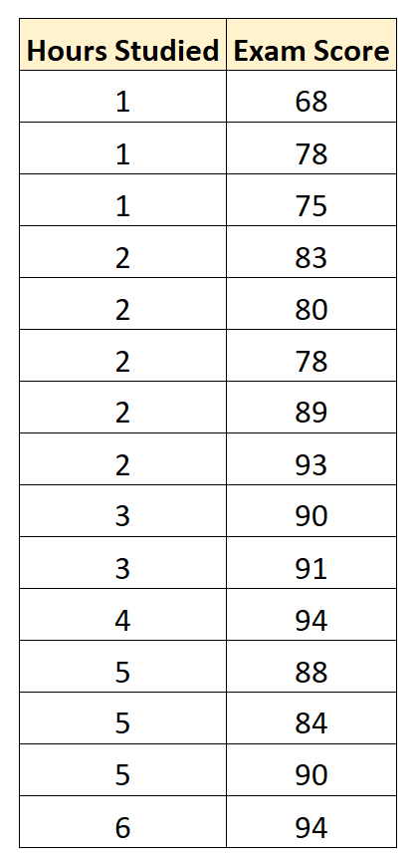
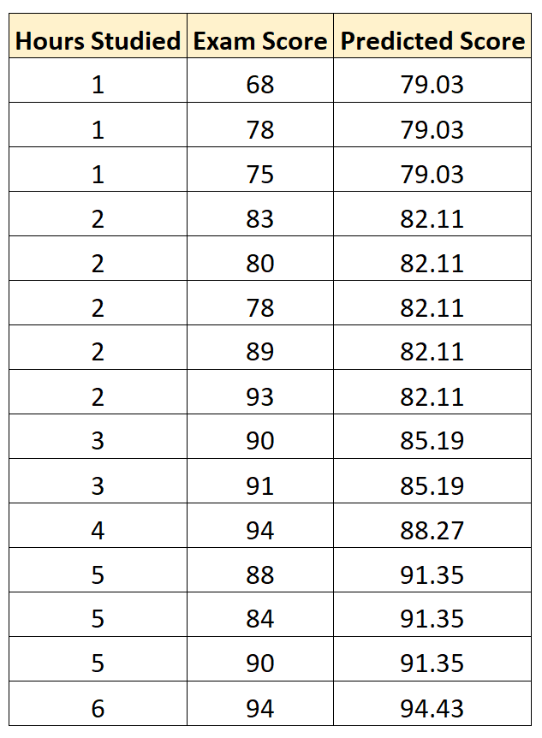
4. RMSE
Root Mean Squared Error (RMSE) is the square root of the mean squared error between the predicted and actual values.
Where p is predicted value, a is actual value and n is total number of observations
The closer RMSE is to 0, the more accurate the model is. Example is as shown below:-
Regression Model is as
Exam Score = 75.95 + 3.08*(Hours Studied)

Slide 12
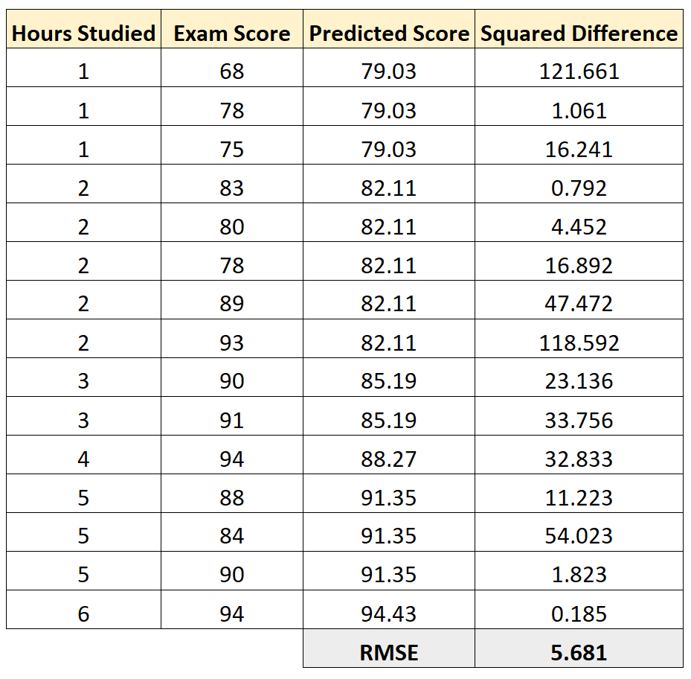
RMSE Example
We can then calculate the squared difference between each predicted exam score and the actual exam score. Then we can take the square root of the mean of these differences:
The RMSE for this regression model turns out to be 5.681.

Slide 13

5.MAE
Absolute Error is the amount of error in your measurements. It is the difference between the measured value and “true” value. For example, if a scale states 90 pounds but you know your true weight is 89 pounds, then the scale has an absolute error of 90 lbs – 89 lbs = 1 lbs.
The Mean Absolute Error(MAE) is the average of all absolute errors. The formula is:
Predicted height | Actual height | Actual difference
188 | 180 | 8
180 | 160 | 20
175 | 170 | 5
148 | 150 | 2
203 | 200 | 3
184 | 190 | 6
150 | 140 | 10
The MAE for these predictions is:
MAE = 7.71
The interpretation of this value is:
The average error between the predictions and actuals in this dataset is 7.71, which is likely a good value considering the average actual height is 170.

Slide 14
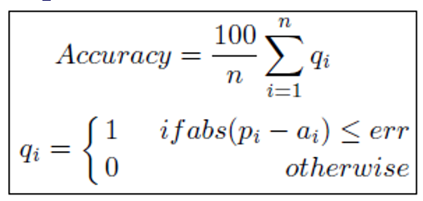
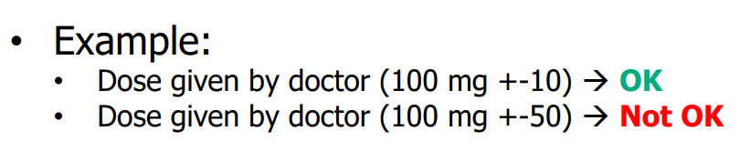
6. Accuracy
The accuracy is calculated as percentage deviation of predicted target with actual target (with or without acceptable error).

Slide 15
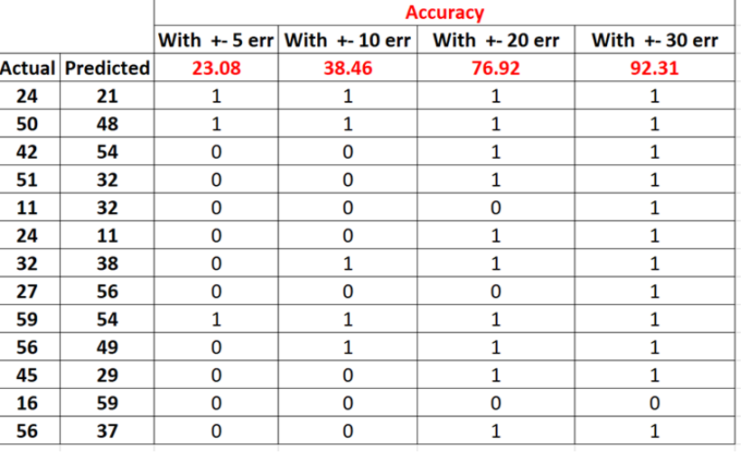
Accuracy Illustration

Slide 16
Evaluation Metrics- Numerical Example
Consider that the number lectures per day (x) affects the number of hours spent at university per day (y).
The equation of the regression line is
y∧ =0.143+1.229x
Find
(i) MAE
(ii) MSE
(iii) RMSE
(iv) R² Score
For the test set shown in Table
S.No | X | Y
1 | 2 | 2
2 | 3 | 4
3 | 4 | 6
4 | 6 | 7

Slide 17
Evaluation Metrics- Numerical Example
S.No | x | y | y ∧ =0.143+1.229x | Error=y-y’ | MAE | Sq.Error
1 | 2 | 2 | 2.601 | -0.601 | 0.601
2 | 3 | 4 | 3.83 | 0.17 | 0.17
3 | 4 | 6 | 5.059 | 0.941 | 0.941
4 | 6 | 7 | 7.517 | -0.517 | 0.517
 |  | 19 |  | 2.229

Slide 18
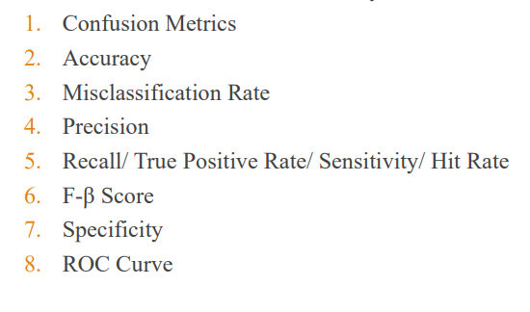
Model Evaluation Parameters
For Classification

Slide 19
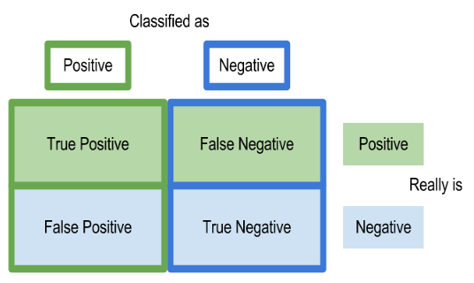
Confusion Matrix

Slide 20
Confusion Matrix
True positives (TP): We predicted yes and the actual value is also yes.
True negatives (TN): We predicted no, and the actual value is also no.
False positives (FP): We predicted yes, but the actual value is no. (Also known as a "Type I error")
False negatives (FN): We predicted no, but actual value is yes (Type II error)
Example:-
Predicted | Actual
 | Mango | Orange | Banana
Mango | T P | F P | F P
Orange | FP | TP | FP
Banana | FP | FP | TP

Slide 21
Which error (Type I/Type II) is important?
Sometimes it is not possible to minimize both the error. So it depends upon the application that which error is more important to minimize.
Consider an application of classifying a patient as cancer or non-cancer patient. Diagnosing a cancer patent as non cancer(FN) is more important than non-cancer patent as cancer (FP). So FN must be minimized in this case.
Consider email classification app which classifies mail as spam or ham. Classifying a ham mail as spam (FP) is more important than spam as ham(FN). So FN must be minimized.

Slide 22
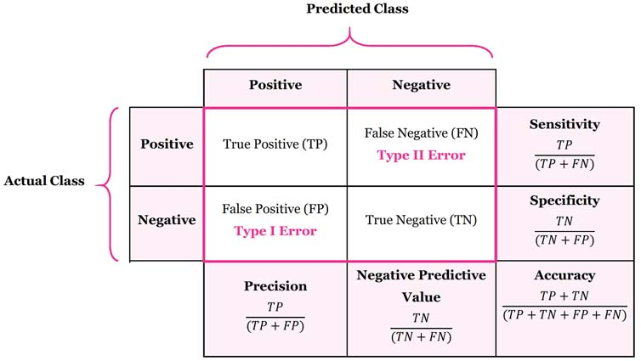
Expanded Confusion Matrix

Slide 23
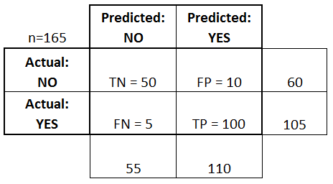
Confusion Matrix Example

Slide 24
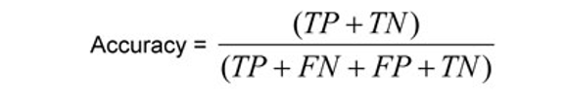
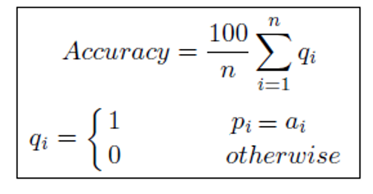
Classification accuracy is used when dataset is balanced.

Slide 25
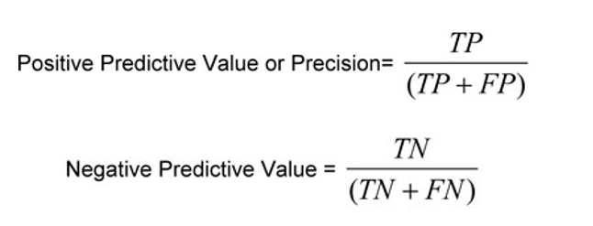
Precision
Precision tells us how many of the correctly predicted cases actually turned out to be positive. The precision for class is calculated as:
Also known as micro precision
Precision is a useful metric in cases where False Positive is a higher concern than False Negatives.

Slide 26
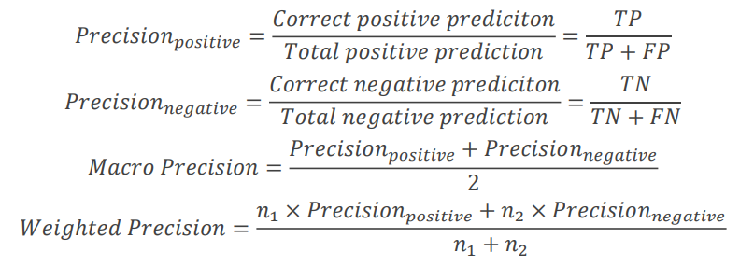
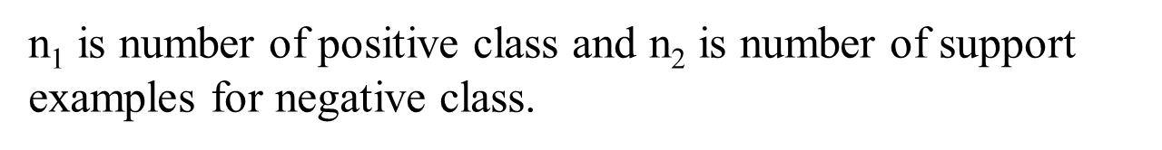
Macro & Weighted Precision

Slide 27
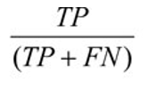
Sensitivity or Recall (True Positive Rate)
It corresponds to the proportion of positive data points that are correctly considered as positive, with respect to all positive data points.
TPR=
Example: To determine what proportion of the actual sick people were correctly detected by the model.

Slide 28
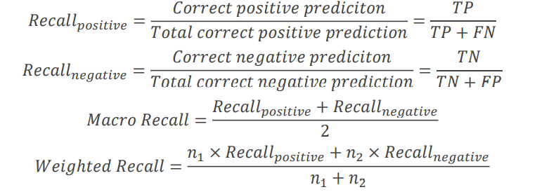
Macro & Weighted Recall
n₁ is number of positive class and n₂ is number of support examples for negative class.
Recall is a useful metric in cases where False Negative trumps False Positive.
Recall is important in medical cases where it doesn’t matter whether we raise a false alarm but the actual positive cases should not go undetected!

Slide 29
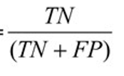
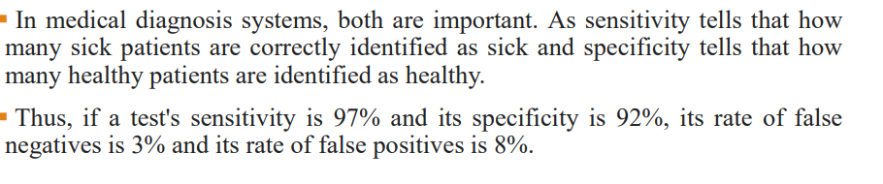
Specificity (True Negative Rate)
It corresponds to the proportion of negative data points that are correctly considered as negative, with respect to all negative data points.
TNR=

Slide 30
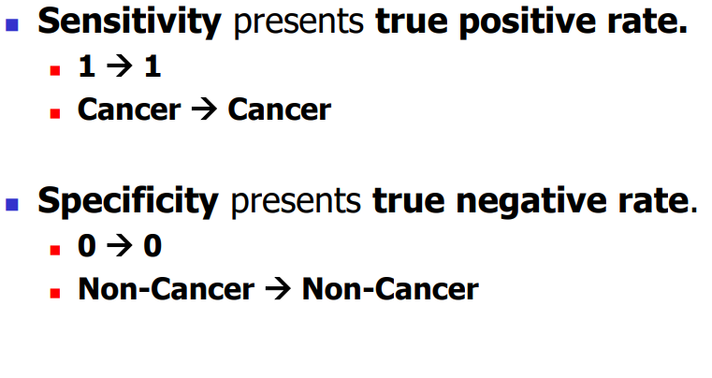
Sensitivity/Specificity

Slide 31
False Positive Rate
FPR: FP / (FP+TN).
False Positive Rate corresponds to the proportion of negative data points that are mistakenly considered as positive, with respect to all negative data points.

Slide 32

False Negative Rate
FNR tells us what proportion of the positive class got incorrectly classified by the classifier.
A higher TPR and a lower FNR is desirable since we want to correctly classify the positive class.

Slide 33
F Score
F1 score is a weighted average score of the true positive (recall) and precision.
It combines the precision and recall of the model, and it is defined as the harmonic mean of the model’s precision and recall.
Harmonic mean between two numbers a and b is defined as
H = 2/ (1/a + 1/b)
H = 2ab/(a+b)

Slide 34


F Score
Take > 1 if we want to give more weightage to recall.
Take <1 if want to give more weightage to precision.
If =1 then

Slide 35
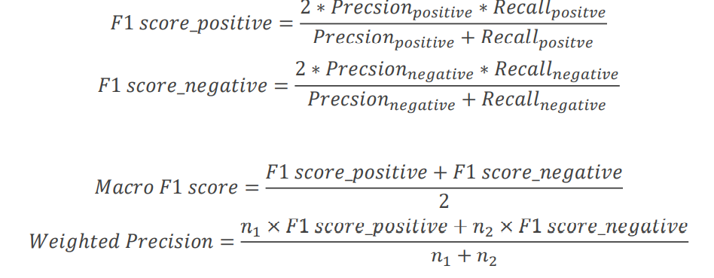
Macro & Weighted F1 Score
Here n₁ is number of positive class and n₂ is number of support examples for negative class.

Slide 36
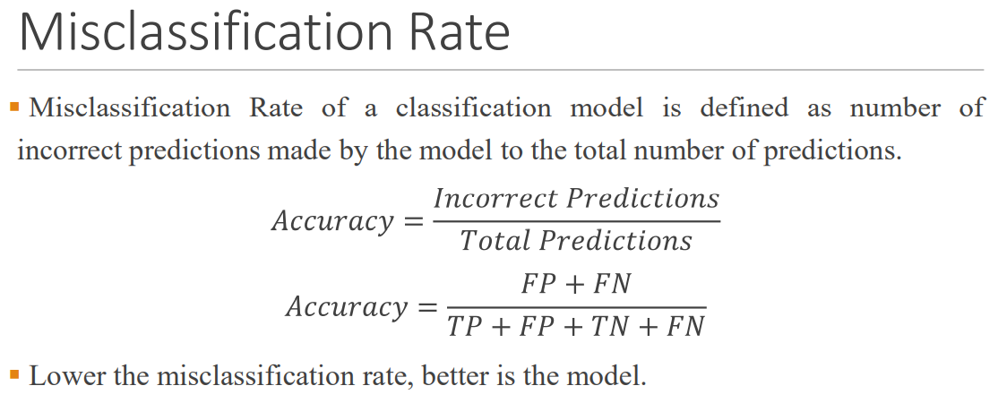
Misclassification Rate

Slide 37
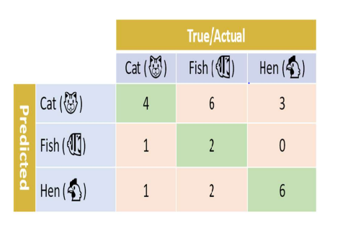
Practice Question
For the confusion matrix, compute
Accuracy
Precision for each class, Macro Precision and Weighted Precision
Recall for each class, Macro Recall and Weighted Recal

Slide 38
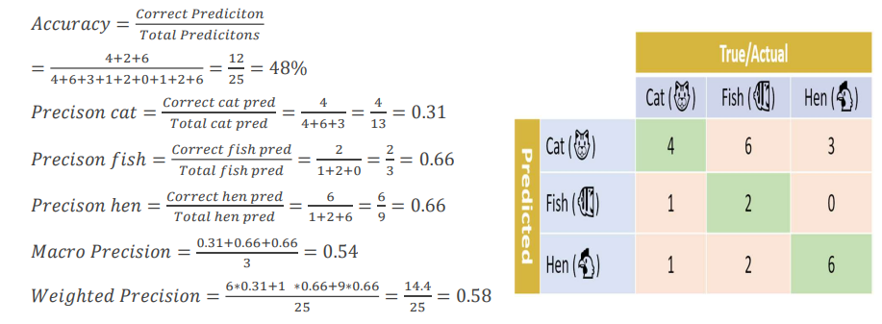
Solution

Slide 39
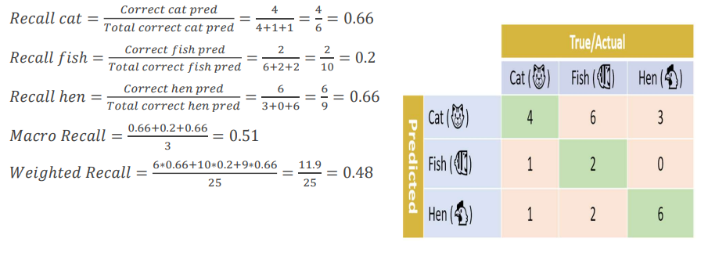
Solution

Slide 40
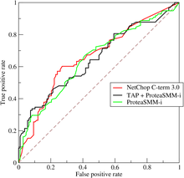
Receiver Operating Characteristic (ROC)
Threshold Selection:
Setting different thresholds for classifying positive class for data points will inadvertently change the Sensitivity and Specificity of the model.
One of these thresholds will probably give a better result than the others, depending on whether we are aiming to lower the number of False Negatives or False Positives.
The ROC curve is created by plotting the true positive rate (TPR) against the false positive rate (FPR) at various threshold settings.
The true-positive rate is also known as sensitivity, recall or probability of detection.

Slide 41
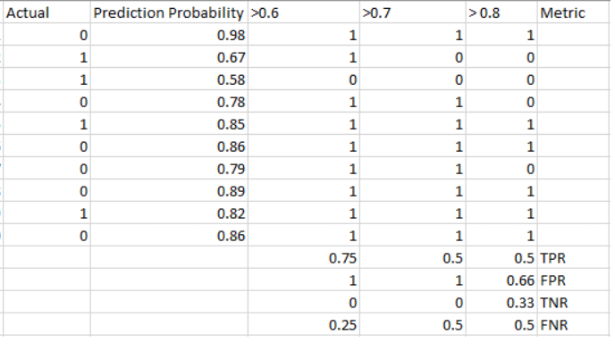
ROC - Illustration

Slide 42
ROC - Illustration
The metrics change with the changing threshold values.
We can generate different confusion matrices and compare the various metrics.
That would not be a prudent thing to do. Instead, what we can do is generate a plot between some of these metrics so that we can easily visualize which threshold is giving us a better result.

Slide 43
ROC - Illustration
It is an evaluation metric for binary classification problems. It is a probability curve that plots the TPR against FPR at various threshold values.
The Area Under the Curve (AUC) is the measure of the ability of a classifier to distinguish between classes and is used as a summary of the ROC curve.
The higher the AUC, the better the performance of the model at distinguishing between the positive and negative classes.

Slide 44
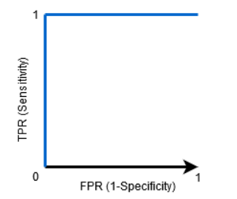
ROC - Illustration
When AUC = 1, then the classifier is able to perfectly distinguish between all the Positive and the Negative class points correctly. If, however, the AUC had been 0, then the classifier would be predicting all Negatives as Positives, and all Positives as Negatives.

Slide 45
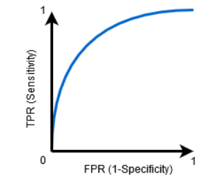
ROC - Illustration
When 0.5<AUC<1, there is a high chance that the classifier will be able to distinguish the positive class values from the negative class values. This is so because the classifier is able to detect more numbers of True positives and True negatives than False negatives and False positives.

Slide 46
Calculate all parameters for
Actual | Probability | Predicted(0)
1 | 0.89 | 1
0 | 0.96 | 1
1 | 0.46 | 1
1 | 0.35 | 1
0 | 0.23 | 1
1 | 0.75 | 1
TPR =4/(4+0) =1
FPR =2/(2+0) =1

Slide 47
Calculate all parameters for
Actual | Probability | Predicted(0.25)
1 | 0.89 | 1
0 | 0.96 | 1
1 | 0.46 | 1
1 | 0.35 | 1
0 | 0.23 | 0
1 | 0.75 | 1
TPR =4/(4+0) =1
FPR =1/(1+1) =0.5

Slide 48
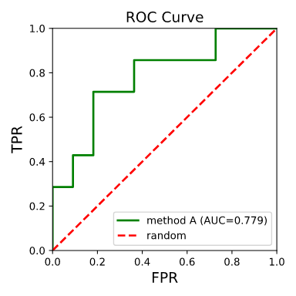
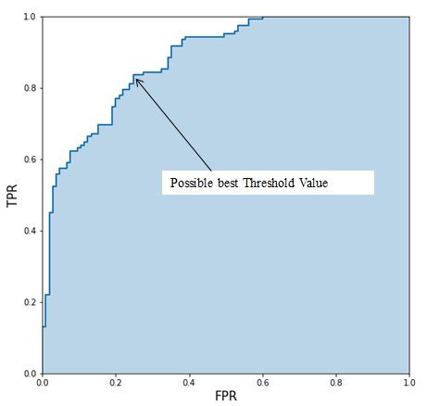
Note: The top-left value on the ROC curve should give you a quite good threshold.

Slide 49
Example:
Actual | Predicted
1 | 0
1 | 1
0 | 1
1 | 0
0 | 1
0 | 1
0 | 1
0 | 0
1 | 0
0 | 1

Slide 50


